Slide 1

My Linear Relationships Interactive Notebook
Name
Class
Teacher
Semester 2
Term 4
1

Slide 2

Interactive Notebooks!
Cover Page
Contents Page
Glossary
24/7/30
EQ
Questions
Notes
Summaries
Work page
Presentation!!!
Your book, your responsibility!

Slide 3


Slide 4
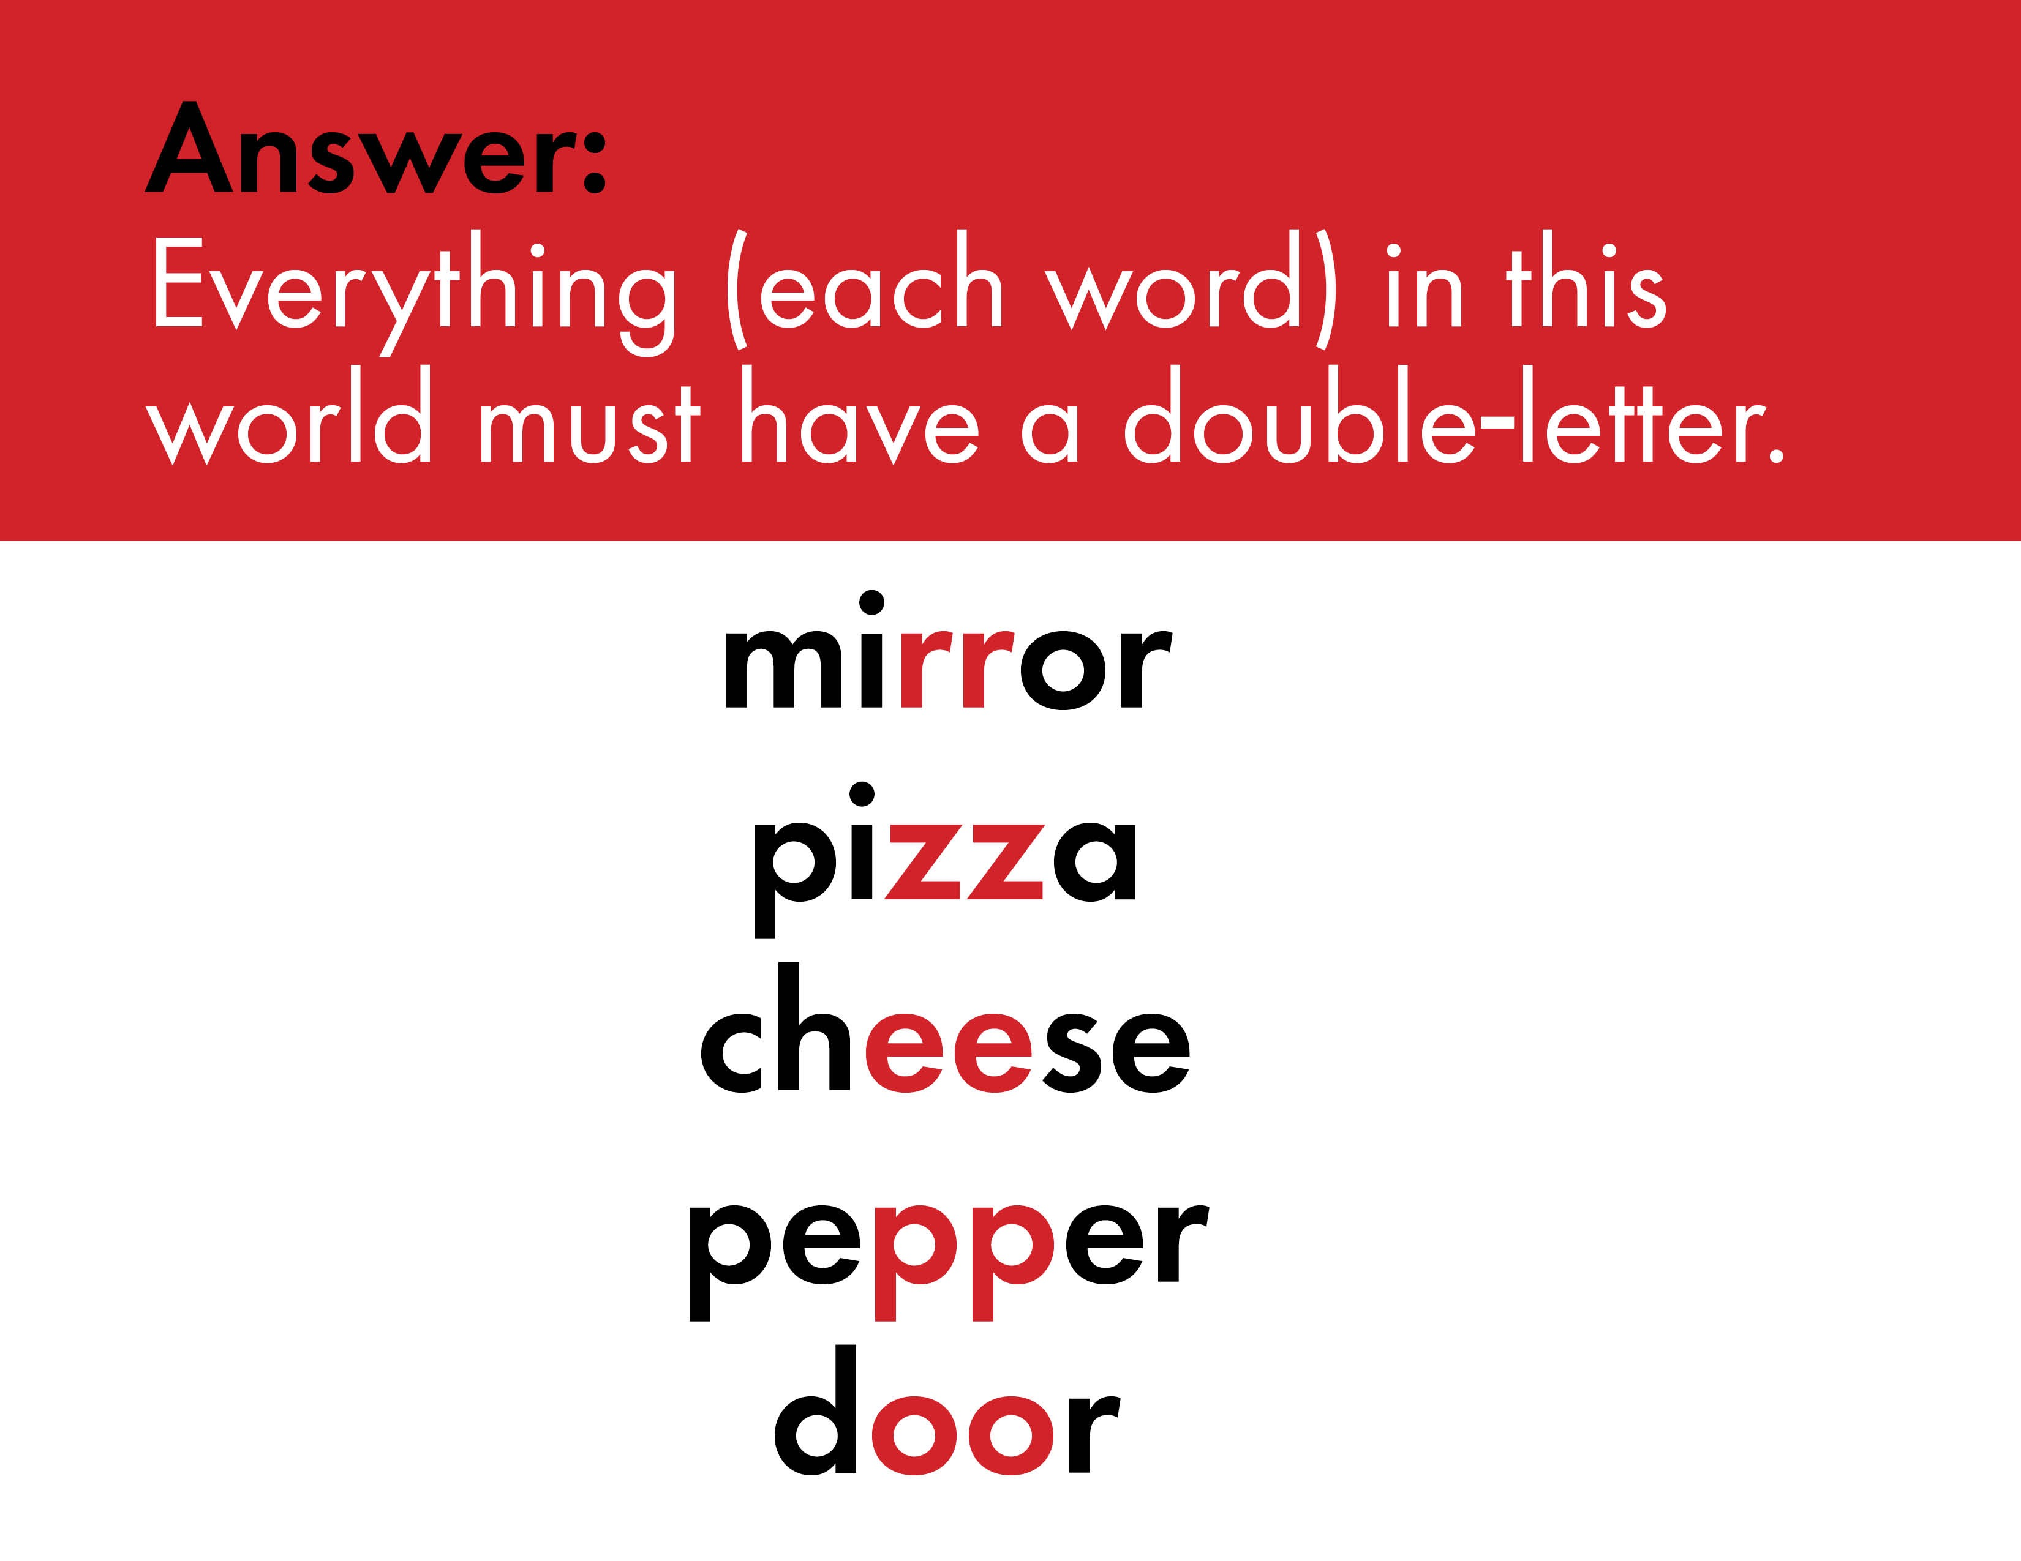

Slide 5


Slide 6
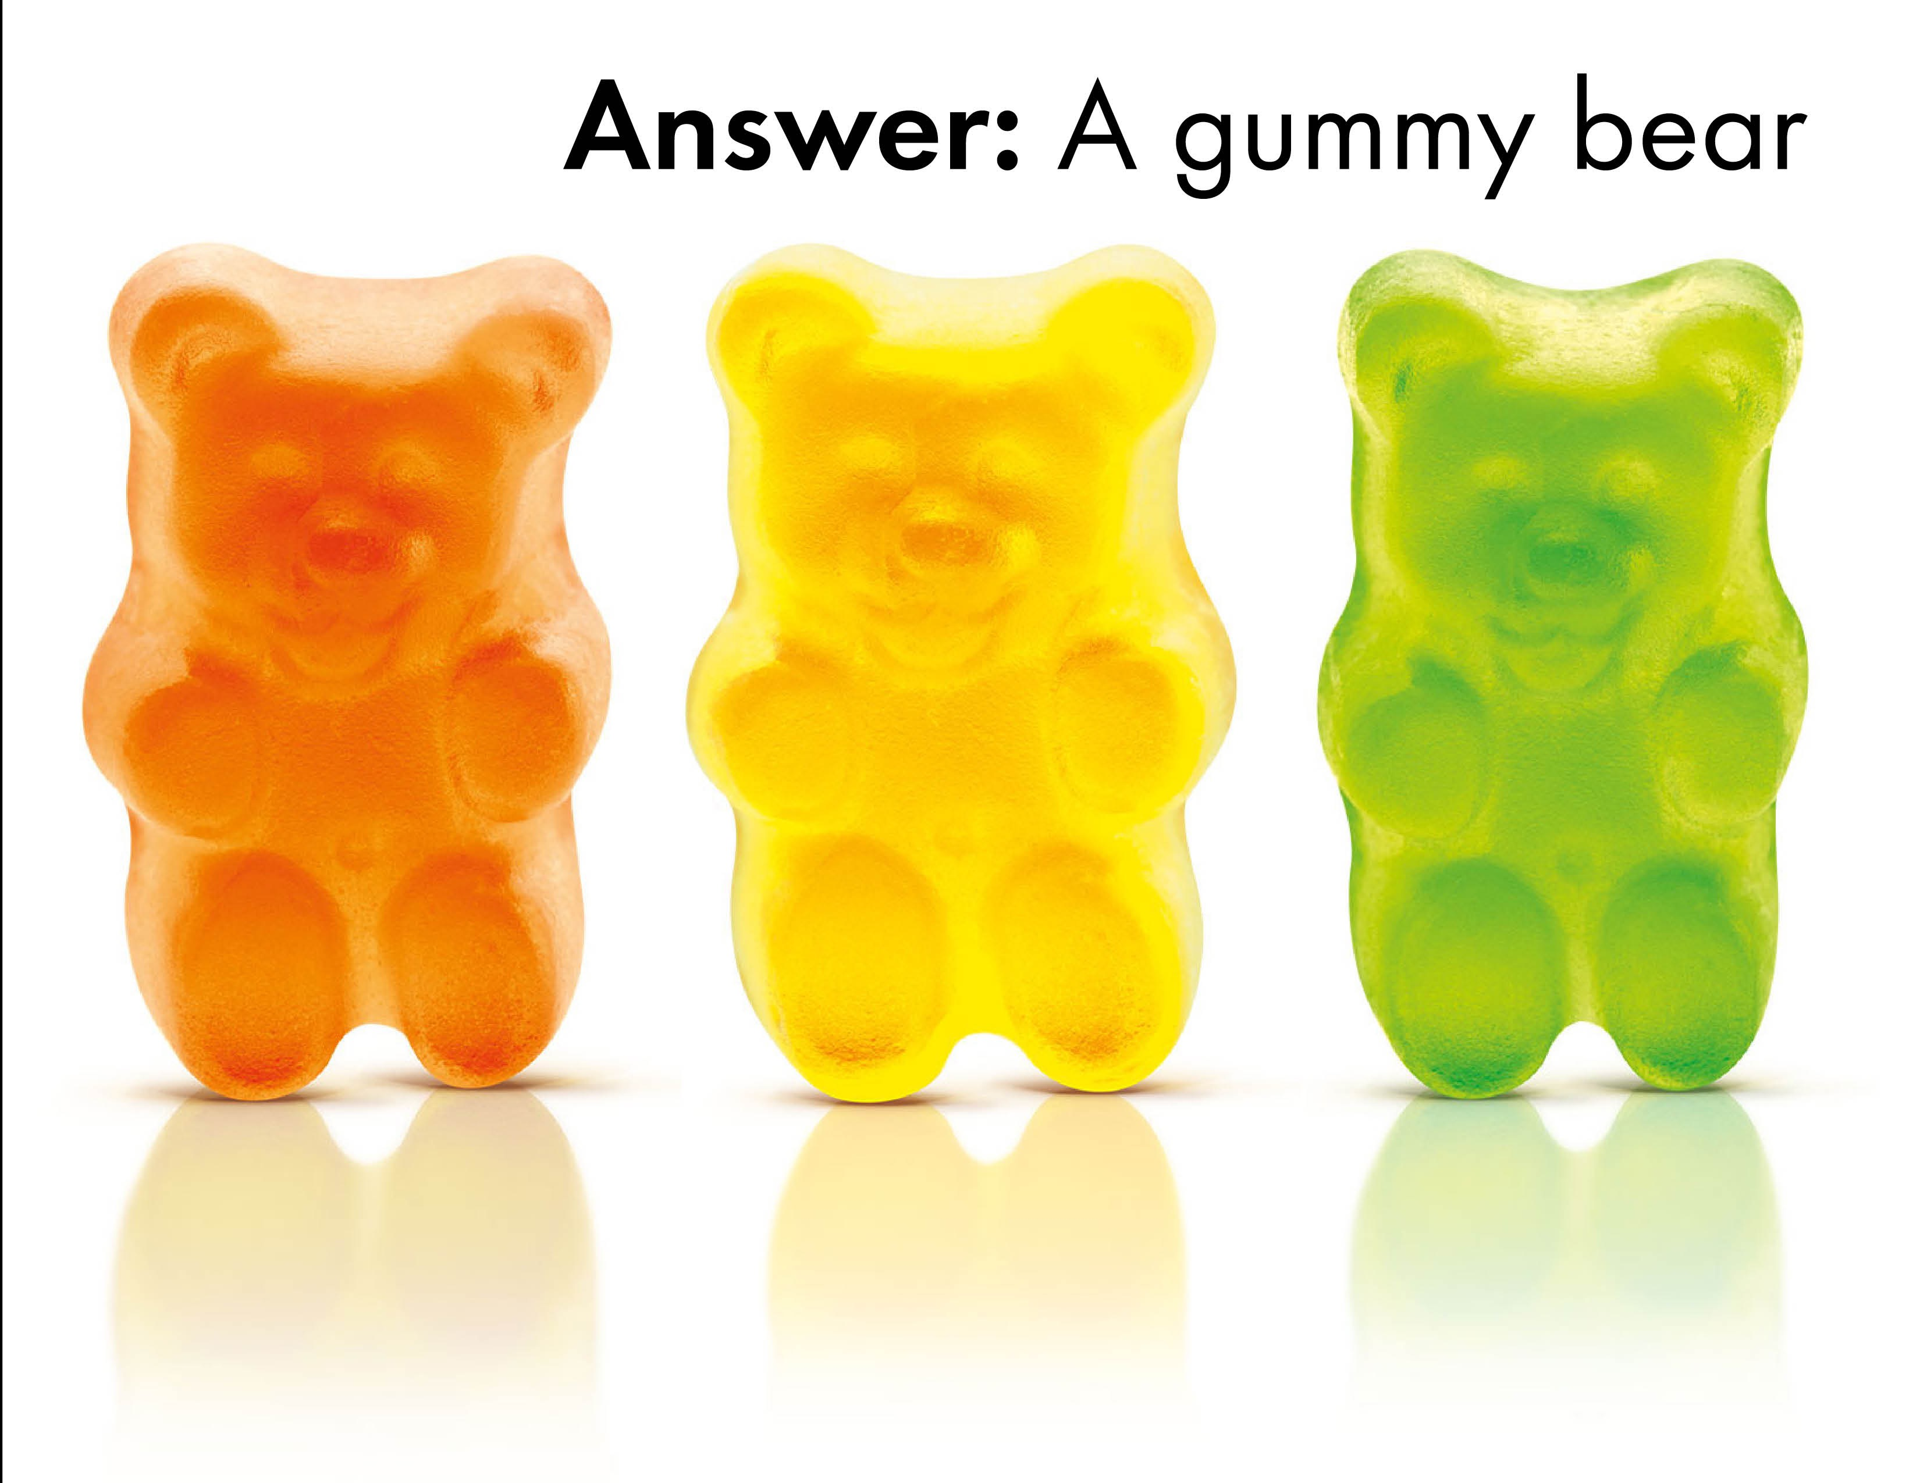

Slide 7
Handout Linear Relations Worksheet

Slide 8
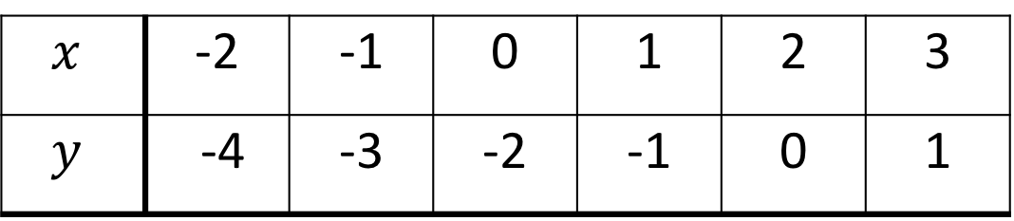
24
7
30
Date
Linear Relationships Review
EQ – How are rules, tables, graphs and intercepts all related?
The basics:
Coordinates can also be written in a table to organise them and make them easier to graph.
Consider the following set of coordinates:
(0, -2) (3, 1) (-1, -3) (1, -1) (-2, -4) (2, 0)
Step 1: Put them in order by the x-value (first number)
(-2, -4) (-1, -3) (0, -2) (1, -1) (2, 0) (3, 1)
Step 2: Place the x values in the table, ensuring they go up by the same amount each time.
Step 3: Place the corresponding y values in the table.
$$x$$ | -2 | -1 | 0 | 1 | 2 | 3
$$y$$ | -4 | -3 | -2 | -1 | 0 | 1
11

Slide 9
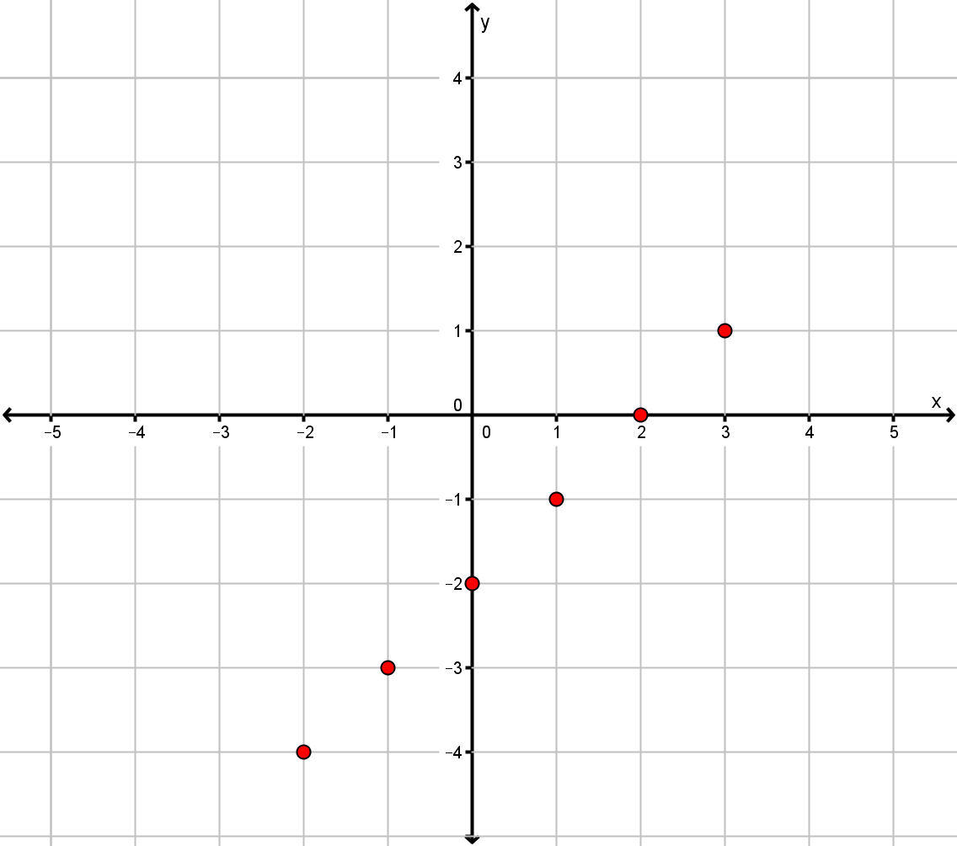
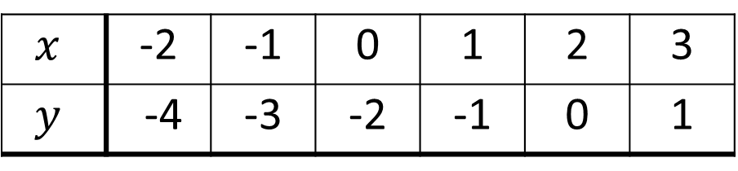


24
7
30
Date
Linear Relationships
EQ – How are rules, tables, graphs and intercepts all related?
Plot each pairs of numbers in the table as if they were coordinates and then join them up with a straight line (with arrows at the end).
$$x$$ | -2 | -1 | 0 | 1 | 2 | 3
$$y$$ | -4 | -3 | -2 | -1 | 0 | 1
$$y$$
$$x$$
11

Slide 10
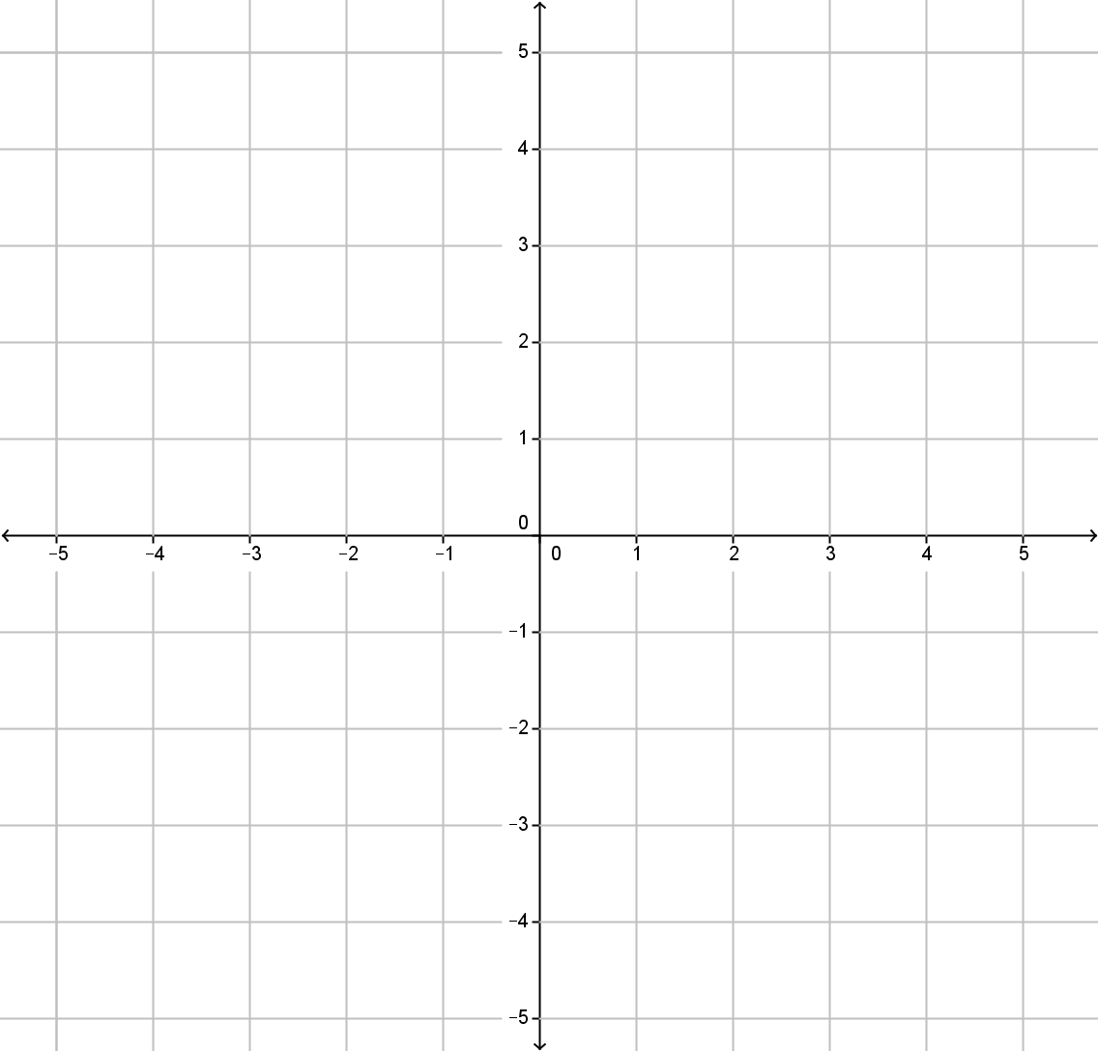


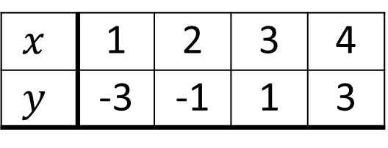
Your Turn (LHS of course)
Draw a coordinate grid from -5 to 5 on both axes (as below) and plot the following table of coordinates.
$$y$$
$$x$$ | 1 | 2 | 3 | 4
$$y$$ | -3 | -1 | 1 | 3
$$x$$

Slide 11
Your Turn (LHS of course)
Draw a coordinate grid from -5 to 5 on both axes (as below) and plot the following tables of coordinates.
$$y$$
(a)
$$x$$ | 1 | 2 | 3 | 4
$$y$$ | -3 | -1 | 1 | 3
$$x$$

Slide 12
Do Questions 1 and 2 of Worksheet

Slide 13
24
7
30
Date
Linear Relationships
EQ – How are rules, tables, graphs and intercepts all related?
How do we turn a rule into a table of values an a graph?
Consider the equation y = 2x + 1
Create a table using x values from -2 to 2
Draw a graph using this table
y = 2x + 1
x | -2 | -1 | 0 | 1 | 2
y = 2x + 1
y | -3 | -1 | 1 | 3 | 5
We use substitution:
y = 2(-2) + 1
= -4 + 1
= -3

Slide 14
Do Questions 3 and 4 of Worksheet

Slide 15
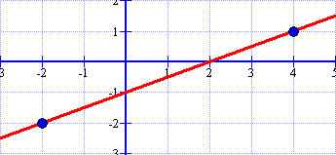
24
7
30
Date
Linear Relationships
EQ – How are rules, tables, graphs and intercepts all related?
How do we calculate gradient and y-intercepts?
Consider the following line on a graph:
How do we calculate the gradient of this line?

Slide 16
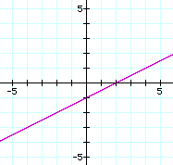
24
7
30
Date
Linear Relationships
EQ – What are gradient and y-intercepts and how do we measure them?
To calculate gradient: Start with the lower point and count how much you rise and run to get to the other point!
rise
3
=
=
run
6
6
3
Notice the slope is positive AND the line increases!

Slide 17
24
7
30
Date
Linear Relationships
EQ – What are gradient and y-intercepts and how do we measure them?
Y- Intercept:
The Y-intercept, also represented by c, is simply where the linear function crosses the y-axis!
3
3
3
2
2
2
1
1
1
-1
-1
-2
-1
-2
-1
1
2
3
-2
-1
1
2
3
-1
1
2
3
-2
-2
-2
c = 2
c = 0
c = -1

Slide 18
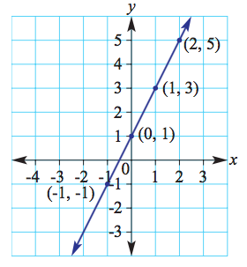
24
7
30
Date
Linear Relationships
EQ – What are gradient and y-intercepts and how do we measure them?
Gradient = $\frac{rise}{run}$ = $\frac{2}{1}$ = 2 which is the same as the coefficient
The constant is 1, which is where the line crosses the y axis
x | -1 | 0 | 1 | 2
y | -1 | 1
+2
2
1
The rule for a straight line graph is given by y = mx + c where:
m is the gradient
c is the y-intercept (where the line passes thru the y – axis)

Slide 19
24
7
30
Date
Linear Relationships
EQ – What are gradient and y-intercepts and how do we measure them?
Find the Gradient and y intercept of these lines.
6
6
Gradient
= 2
Gradient
= -3
4
4
2
Y-intercept
= 1
2
Y-intercept
= 3
-2
2
4
6
-2
2
4
6
-2
-2
-4
-4
y=2x + 1
y=-3x + 3

Slide 20
Do Questions 5-8 from Worksheet

